Slide 1
TECHNO INTERNATIONAL NEW TOWN, KOLKATA
“वायु परीक्षण”
“Vayu Parikshan”
SMART AIR QUALITY MONITORING SYSTEM BASED ON IoT AND WIRELESS SENSOR NETWORK (WSN) FOR LOCALISED ACCURATE MONITORING
Presented by -
Ritam Majumder, Hrishav Karmakar
Department of Electronics and Communication Engineering

Slide 2
01
Increasing global temperatures day by day results in increment of global warming levels which results in irregular and abrupt weather changes worldwide.
Problem Statement
02
This rapidly changing weather affects the daily lives of people in many ways and also the revenue producing sectors of society.
03
Tracking this weather change in a particular location is becoming crucial nowadays.
04
Readily available solutions in the market are very costly and cannot be afforded by everyone.

Slide 3
Solution to the problem
Use of industrial grade and accurate sensor(s) to measure several parameters of the environment to monitor and track weather changes
Efficient monitoring of weather locally
Easily deployable plug and play system that can be used by any individual with basic knowledge of electronics
Easy to implement system for individuals
Low-Cost solution affordable by everyone
The system should be affordable by everyone so that interested personnel can implement it at a local level
Reliable data analysis
The data gathered by the sensor(s) equipped in the system should be analysed correctly to provide accurate weather information to the users

Slide 4
Specifications
Large area coverage
Easy to monitor
The proposed system can gather data from a certain area and can transmit it omnidirectionally at a range of around 8-10 Km and is ideal to implement in remote areas.
Data collected and analysed by the system can be visualized very easily using a user-friendly dashboard of our application.
03
04
Complete solution for everyone
02
05
Green Energy Powered
The system has several sensor(s) equipped in one package at a lower cost than that available in the market.
The whole system is interfaced with Solar Panels to promote Green Energy and to reduce carbon emissions.
Accurate measurement technique
01
06
Low cost
The proposed system is low-cost and easily affordable at the cost of a single sensor available in the market.
The system uses accurate sensors to measure environment parameters and provide accurate data.

Slide 5
1
Farmers and Agriculturists
Weather information is crucial for farmers and agriculturists to make decisions related to planting, irrigation, harvesting, and pest management.
TARGETED USERS
2
Construction Industry
Construction projects are often weather-dependent, and contractors rely on weather forecasts to schedule work, manage resources, and mitigate risks associated with adverse weather conditions.
3
Emergency Services
4
Tourism Industry
Emergency responders, such as firefighters, police, and medical personnel, use weather forecasts to prepare for and respond to natural disasters and weather-related emergencies.
Chemical Factory, Pharmaceutical Factory, Drugs Manufacturing Company, Oil & Natural Gas Extraction & Manufacturing Unit, Coal Fines, and Semiconductor & Chip Manufacturing Company.
Chemical Factory, Pharmaceutical Factory, Drugs Manufacturing Company, Oil & Natural Gas Extraction & Manufacturing Unit, Coal Fines, and Semiconductor & Chip Manufacturing Company.
Tour operators, hoteliers, and travel agencies utilize weather forecasts to plan tourist activities, promote destinations, and ensure the safety and satisfaction of travellers.

Slide 6
Distinctive Characteristic (USP)
Low-Cost
Made In India
The total system is designed to be low-cost and affordable by everyone.
The total system is made in India
Green Energy
Complete Package
The system is powered using solar panels to reduce carbon emissions
The system comprises of many environmental sensors equipped in a complete package
Data Security
Scalibility
The collected from the system is stored in a secured online server
The system has a scope in the market and can be developed as a small or a large scale

Slide 7
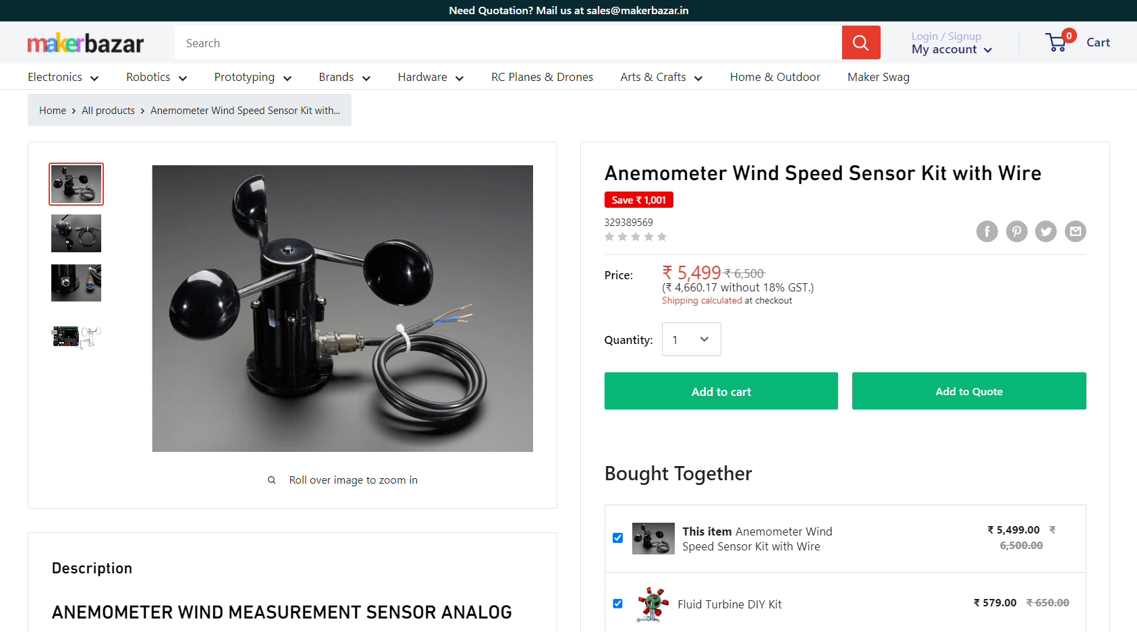
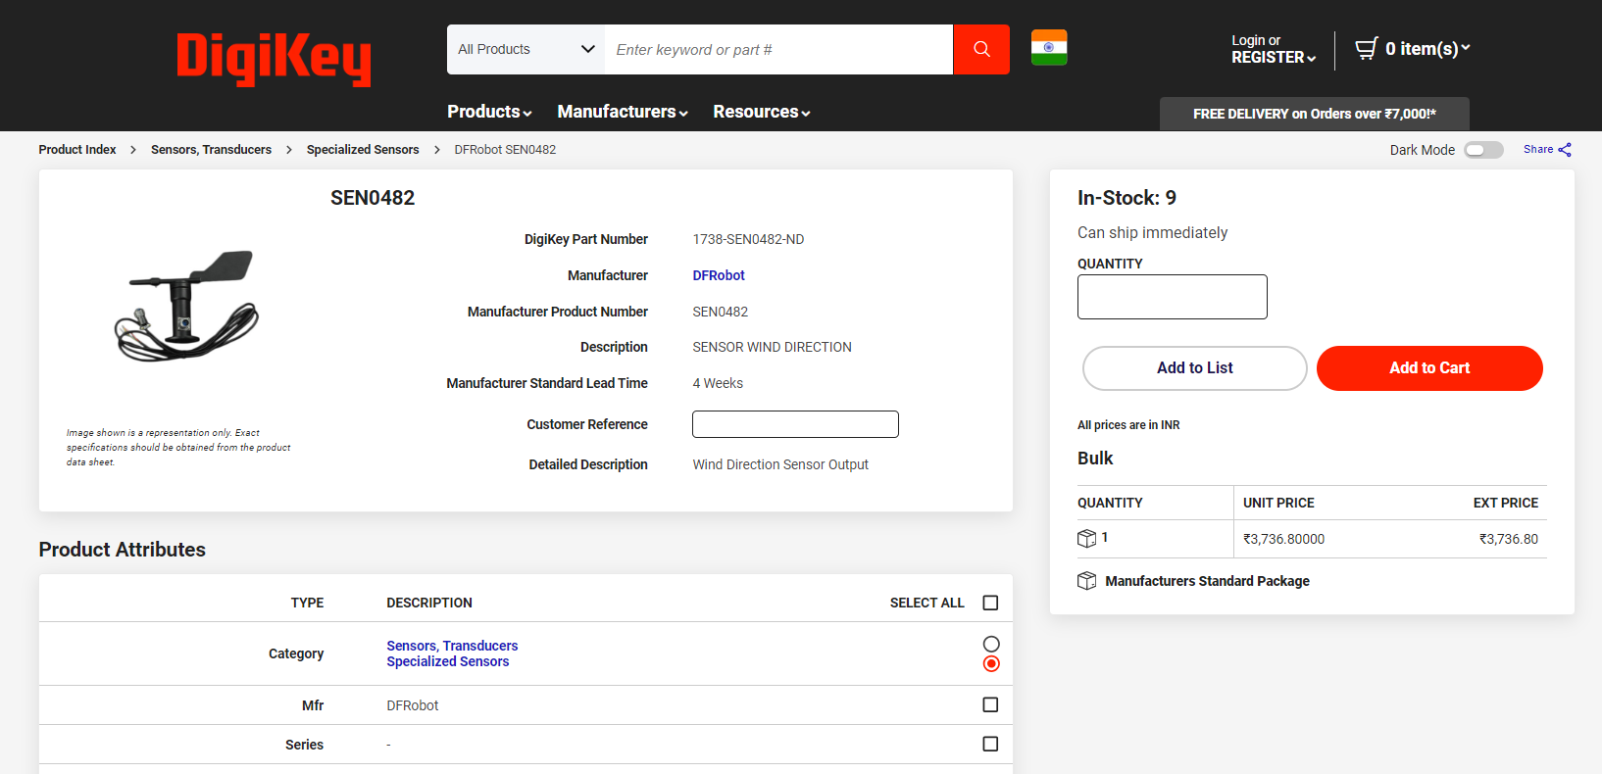
COMMERCIALLY AVAILABLE SENSORS

Slide 8
Cost Breakup
SL. NO. | Sensor Name | Quantity | Price per item | TOTAL
1. | 3d print wind sensor | 1 | 840 | 840
2. | Hall Sensor | 10 | 18 | 180
3. | GY-BME280 Precision Altimeter Atmospheric Pressure Sensor | 1 | 579 | 579
4. | GY-30 BH1750FVI | 1 | 172 | 172
5. | SX1278 LoRa Module | 2 | 500 | 1000
6. | DHT22 Temp Sensor | 1 | 186 | 186
7. | LTR 390 | 1 | 600 | 600
8. | PCB board | 1 | 600 | 600
9. | PCB components | -- | 150 | 150
10. | Miscellaneous electronics | -- | 1000 | 1000
 |  |  |  | 5,307

Slide 9
Conclusion
Complete Weather monitoring solution
Affordable and Easy to use system
Effective for local monitoring
Made in India solution
Interactive dashboard for data visualisation
Accurate data collection and analysis

Slide 10
THANK YOU….

